Slide 1

Stock Market Predictions
Karine Piccoli
Sashi Devulapalli
Data Analytics Boot Camp - UNC Charlotte - 2020

Slide 2


Project purpose
Based on a dataset of TSLA Stock - from 2015 to present , create a Model to Fit in Machine Learning – Linear Regression and predicted next day stock value.
Technologies applied:
Python Pandas
NumPy
Scikit-Learn
Python Matplotlib
Seaborn
Tableau

Slide 3
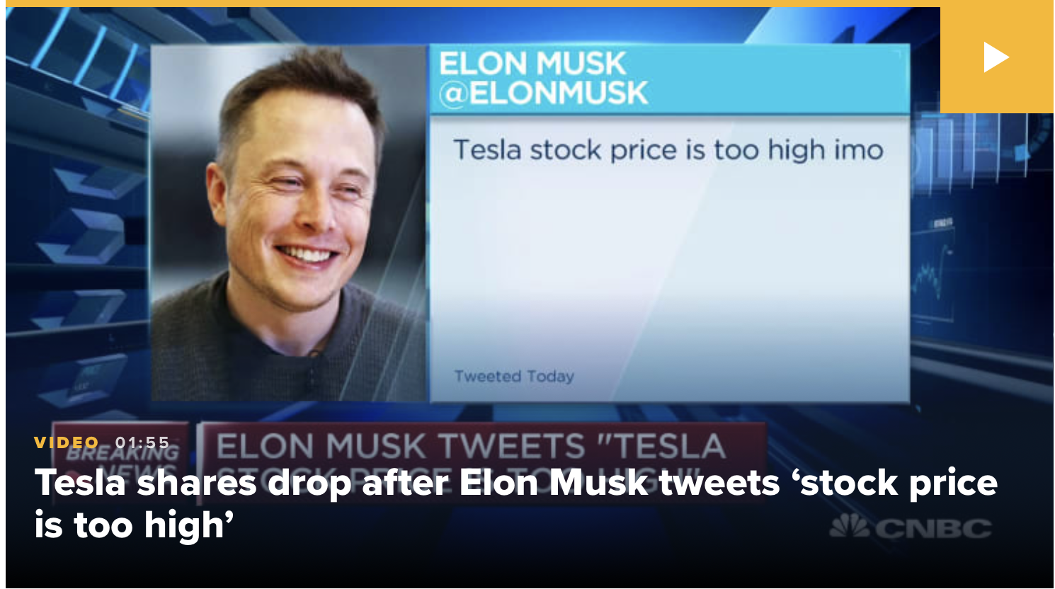
Presenting Tesla
Tesla is an American electric vehicle and clean energy company based in Palo Alto, CA.
It is specialized in electric vehicles manufacturing among other things.
Tesla shares have outperformed other major tech and auto stocks since it went public 10 years ago.
The stock has had plenty of ups and downs along the way.
But shares have rallied this year since the company’s new factory in China came online.
But shares have rallied this year since the company’s new factory in China came online.
Next Aug. 28, Tesla will split its sock for the first time.
Tesla is now gunning for inclusion in the S&P500.

Slide 4
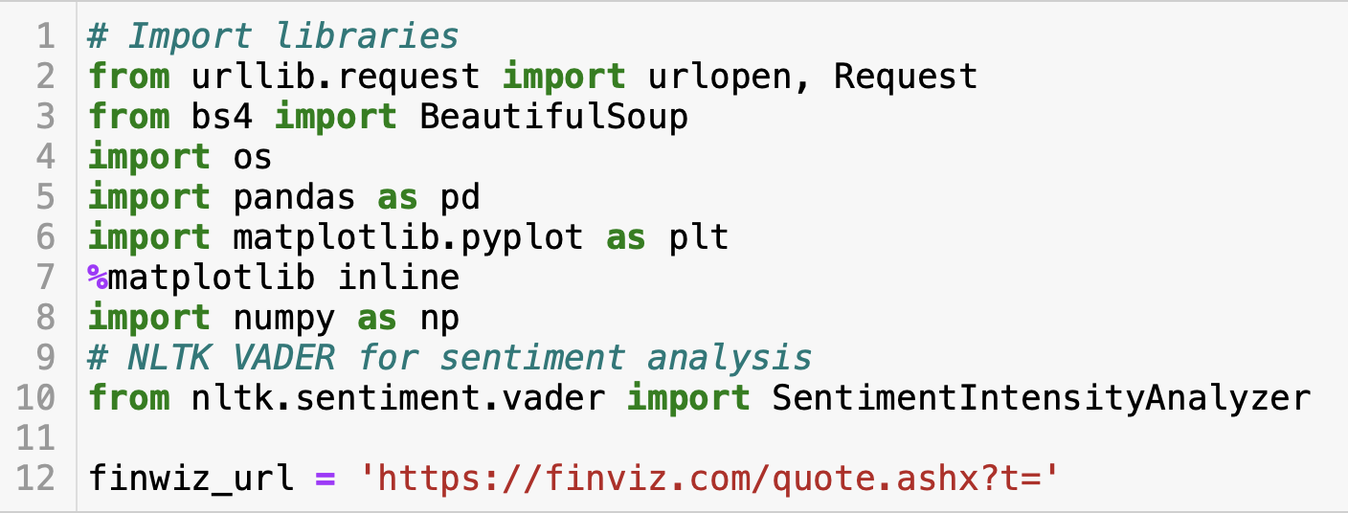
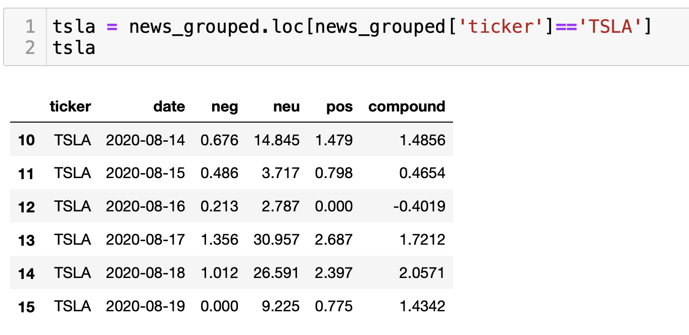
approach
Stock market prices are highly unpredictable and volatile. This means that there are no consistent patterns in the data that allow you to model stock prices over time near-perfectly.
Sentimental analysis could be a strategy together with historical data .
Python and the Natural Language Processing Toolkit (NLTK) generate sentiment scores for a text.
Lack of data for sentimental analysis, change our approach to use historical data for TSLA Stocks at Yahoo Financial. (https://finance.yahoo.com/quote/TSLA/history?p=TSLA)

Slide 5
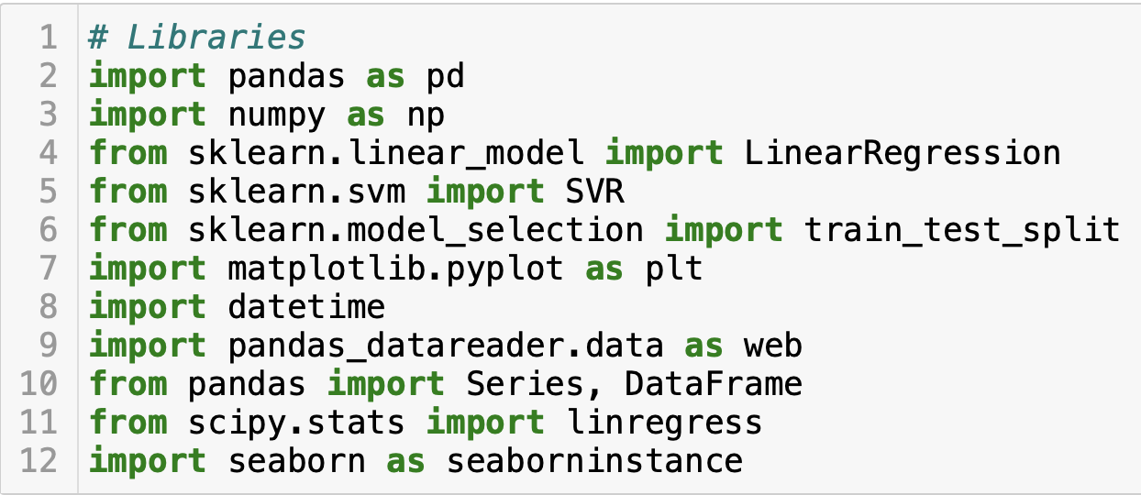
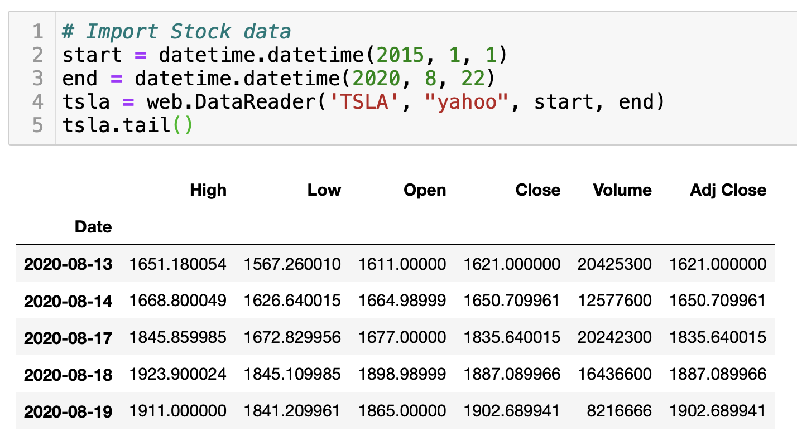
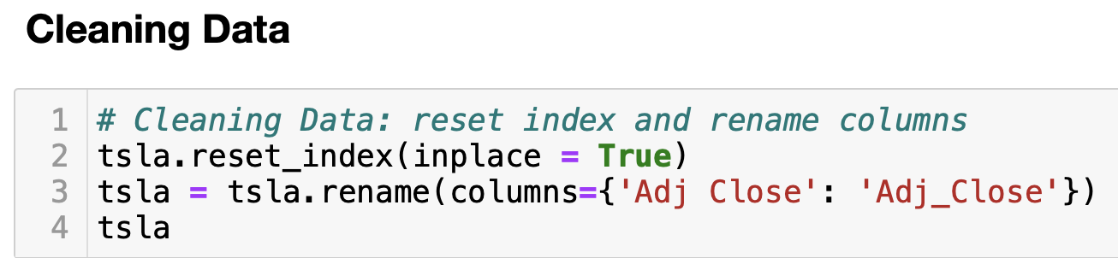
Working In progress

Slide 6
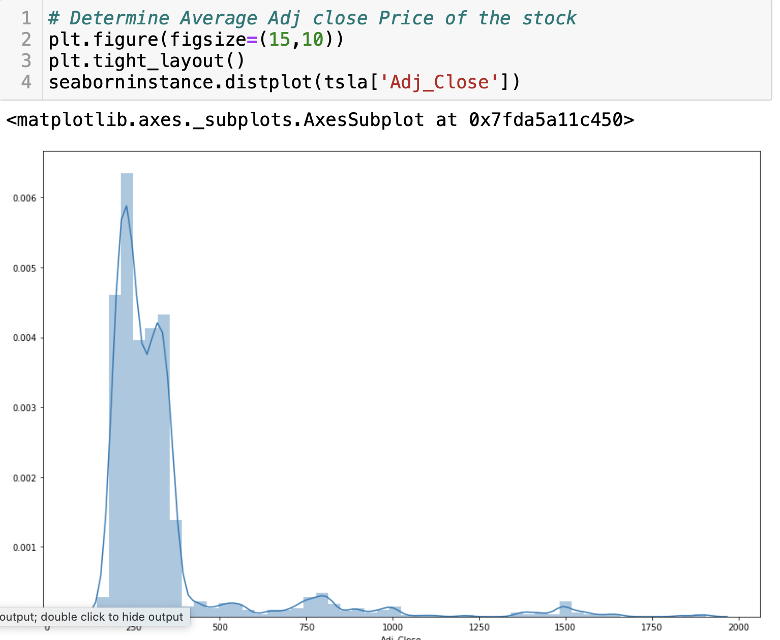
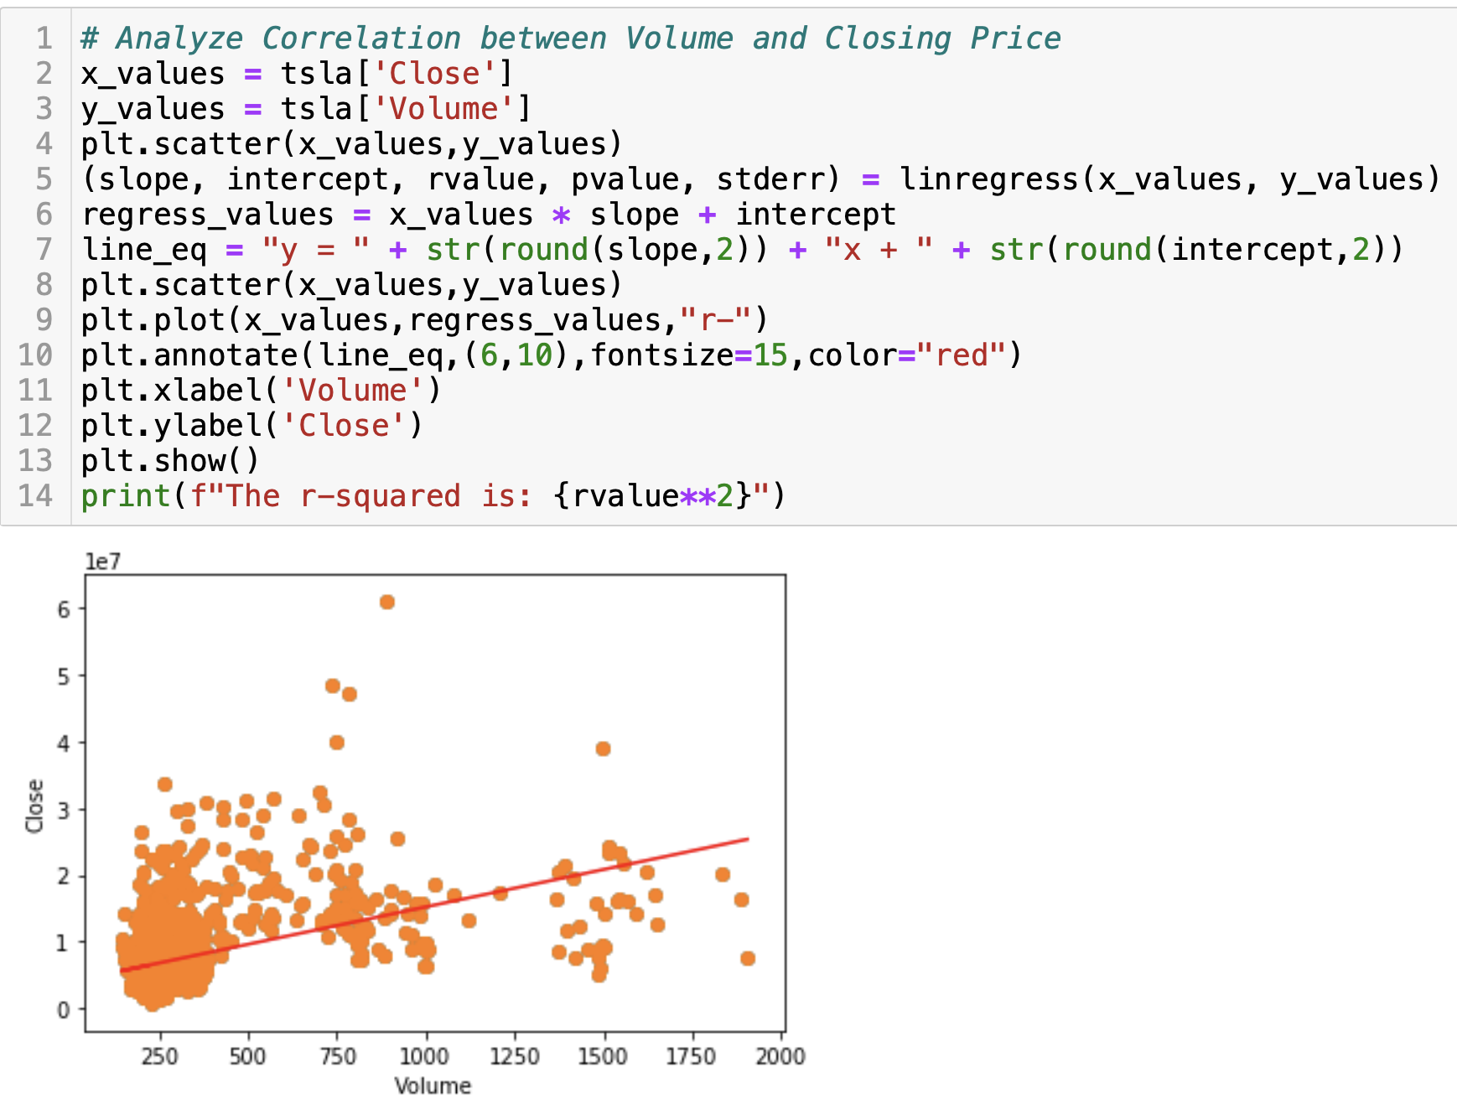
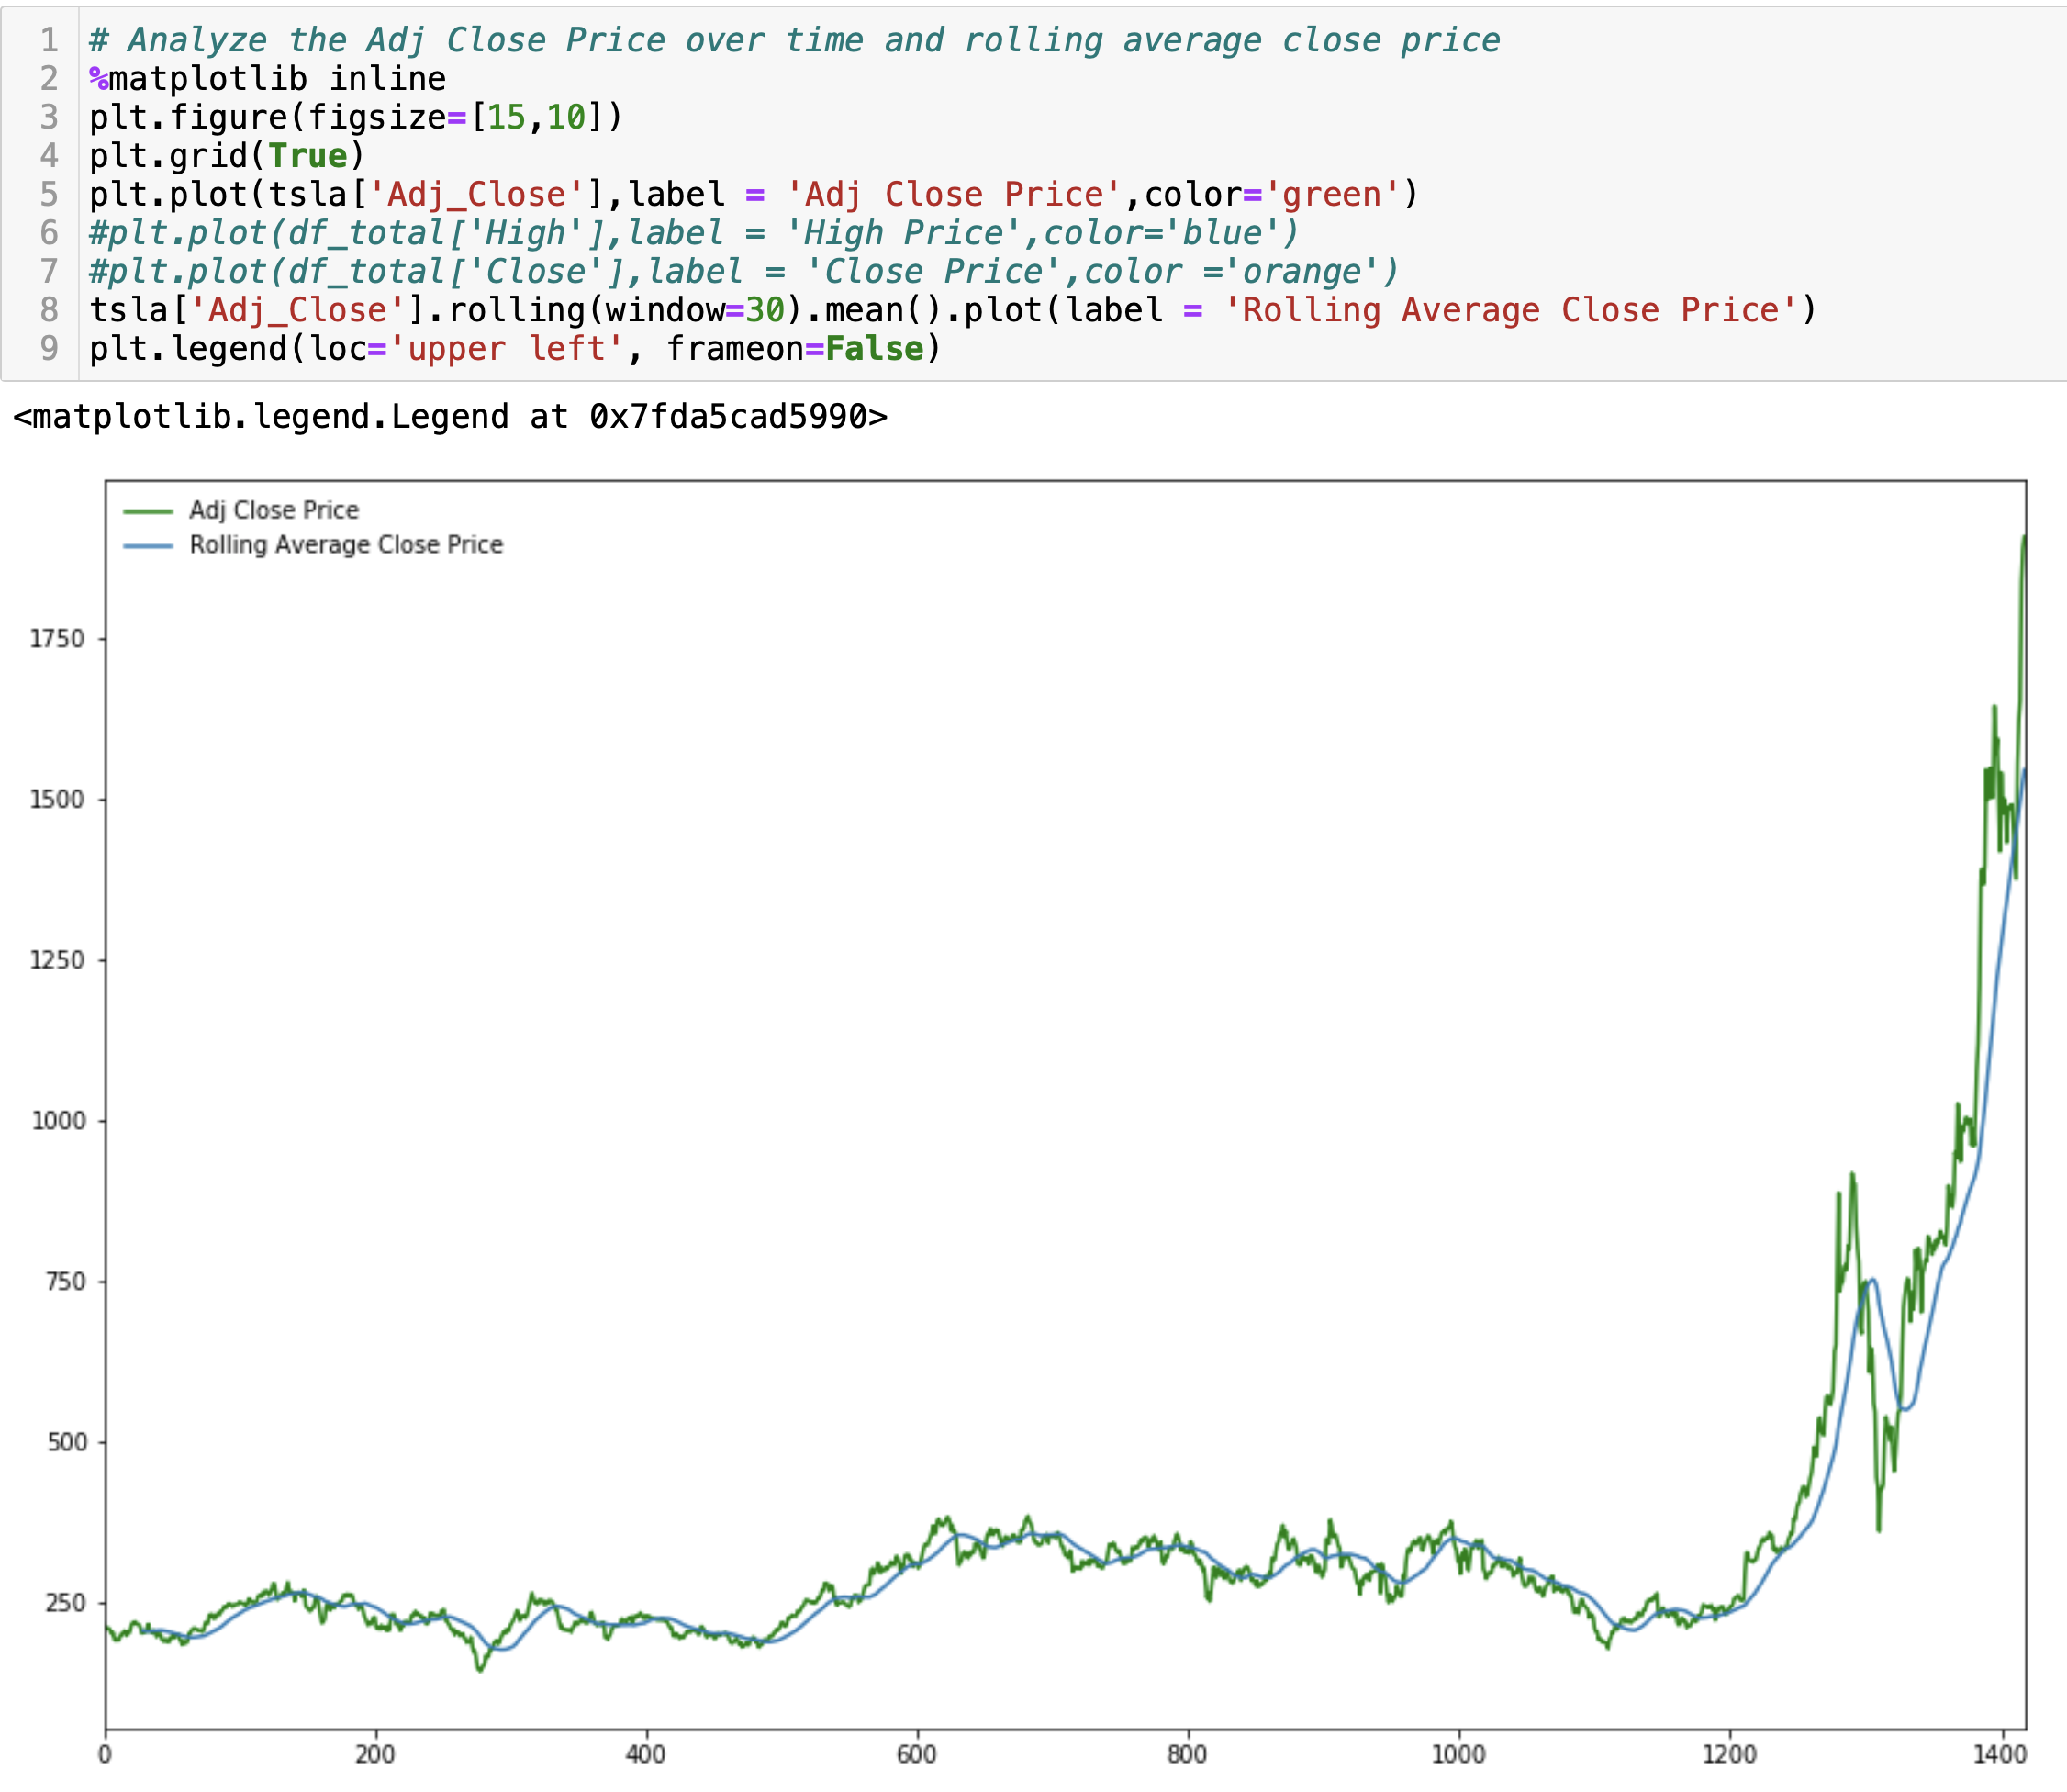
Analyzing Data

Slide 7
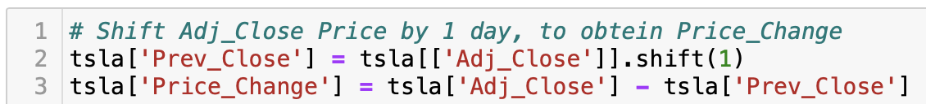
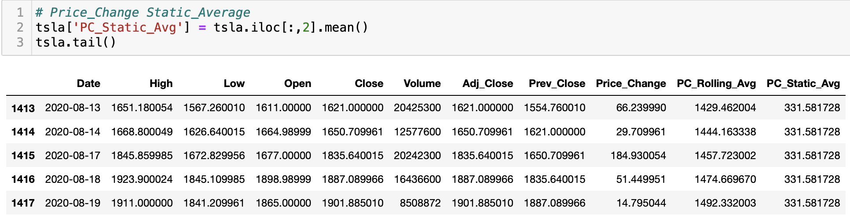
formatting data to feed ml

Slide 8
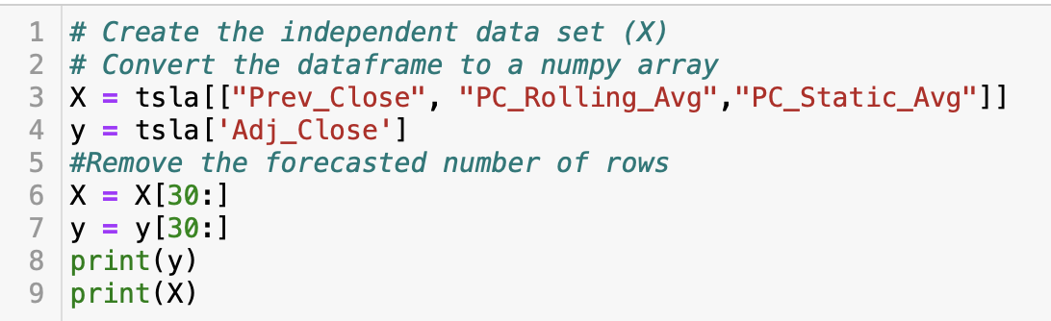
Machine learning Linear regression

Slide 9
Candlestick graph

Slide 10

Thank you
kari.piccoli@gmail.com
Sashi……
Warning: Stock market prices are highly unpredictable and volatile. This means that there are no consistent patterns in the data that allow you to model stock prices over time near-perfectly.

